Slide 1

Weather Balloon
Data Collection Circuit board
Presented by: Ali Alalwia
Date: March 14th, 2025

Slide 2
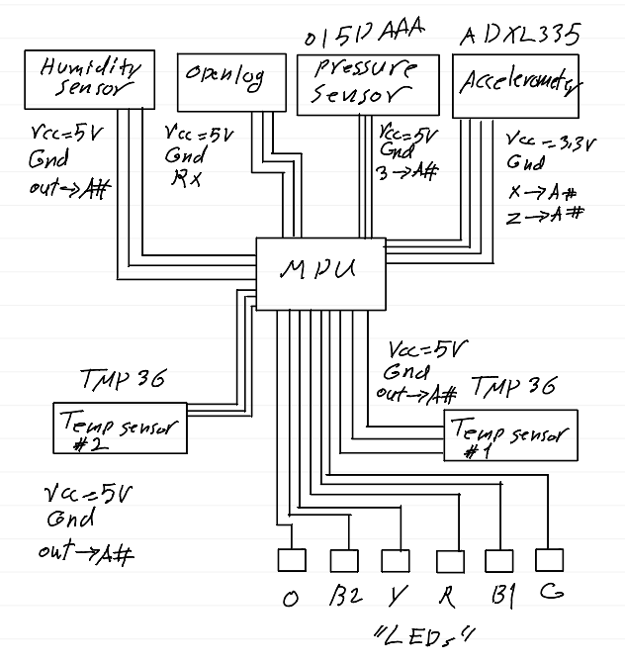
Phase 1:
System was made using Arduino Uno
Arduino Uno shield that holds the sensors
System Estimated Weight is : 200g

Slide 3
System Power Consumption, Cost & Weight :
Item | Current Draw | Price | Weight
HH4030 | 200μA | EOL | 0.0246918 oz
open log (SD Card Module) | 6mA | $16.95 | 0.063493 oz
ADXL335(Gyro Module) | 320μA | $16.95 | 1.600000 oz
Arduino Uno | 75mA | $13.00 | 2.08000 oz
SSCDANV015PAAA5 | 2.7mA | $48.67 | 0.035274 oz
4GB SD Card | ----- | $9.00 | 0.070547 oz
PCB | ----- | $7.00 | 3.00000 oz
LEDS + Resistors | 120mA | $2.00 | 0.127800 oz
TMP36GT9Z(Temp2) | 50μA | $1.00 | 0.007408 oz
DS18B2(Temp1) | 1mA | $5.00 | 1.230000 oz
9V Lithium Battery | ----- | $7.35 | 1.600000 oz
Total: | 205.27mA | $126.92 | 9.839214 oz
Notes:
From the table we notice that using Arduino uno increases the current draw and result in more power consumption it also adds more weight to the total system weight and cost
Humidity sensor is more expensive and is not available it reached it’s end of life
Gyro module is expensive as a result it increases total system cost.

Slide 4
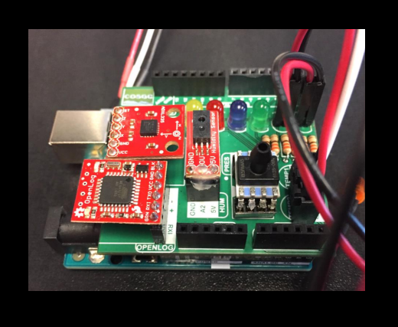
System Feasibility:
The system is not feasible without substituting a certain components:
Humidity sensor other components are expensive which increases the total cost of the system and depending on the budget system might not be feasible if the available budget is less than the total cost of the system.
Total Power consumption :
Total system current draw = 207.27mA
Arduino Uno consumes 75 mA * 9 volts = 675mW
Sensors power consumption = 130.27 at 5 volts = 651.35mW
Total power consumption 675mW + 651.36mW = 1326.36mW
Using a 9v (1200mAh) Lithium battery we get 1200mAh/207.27mA = 5.79 hours
Total Weight of the system: 9.839214 oz or 278.94g
Total cost of the system: was estimated at $126.92
Notes:
Part of the design process was to calculate the total weight of the PCB with all the components the cost of the system and power consumption.

Slide 5
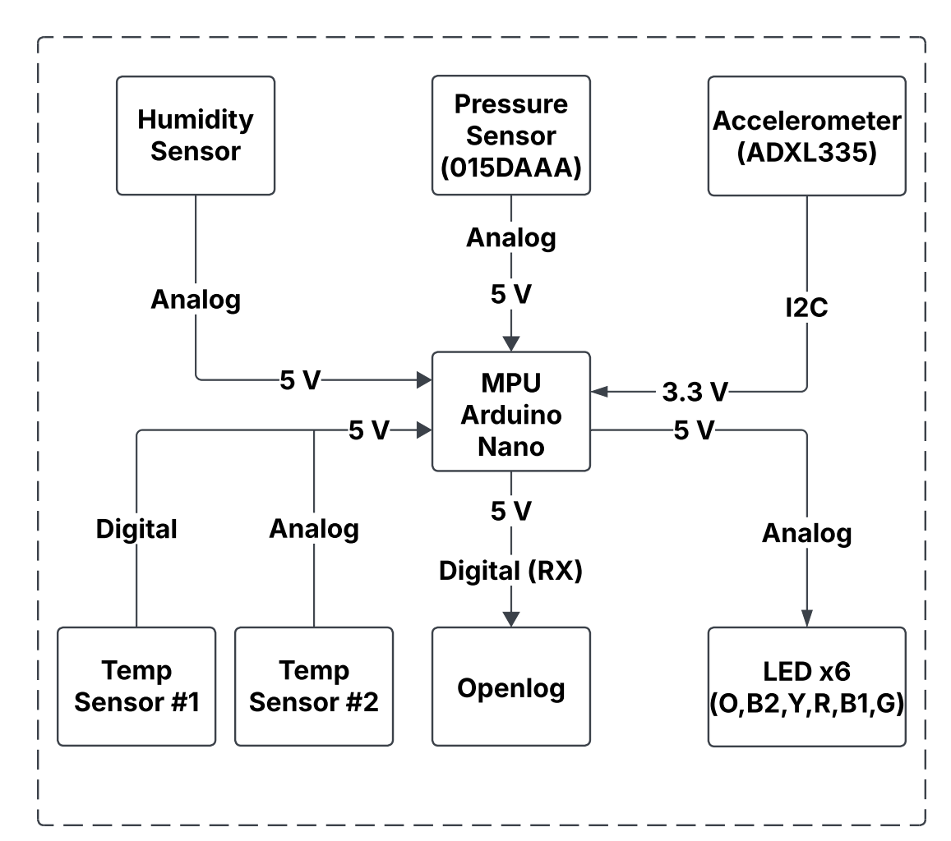
Phase 2: Block Diagram:
Notes:
The block diagram of the system remained the same But Some components were changed to reduce total Cost, weight and power consumption making the system more efficient.
A custom BCP was made to accommodate the new system components.

Slide 6
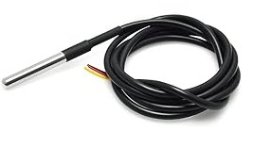
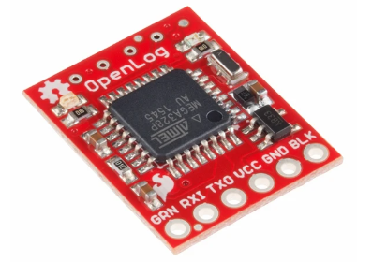

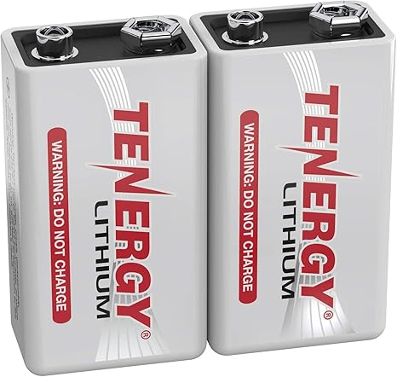
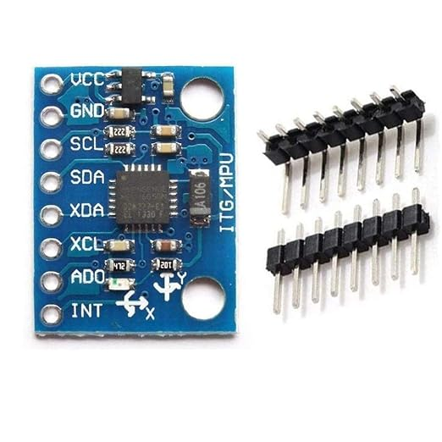
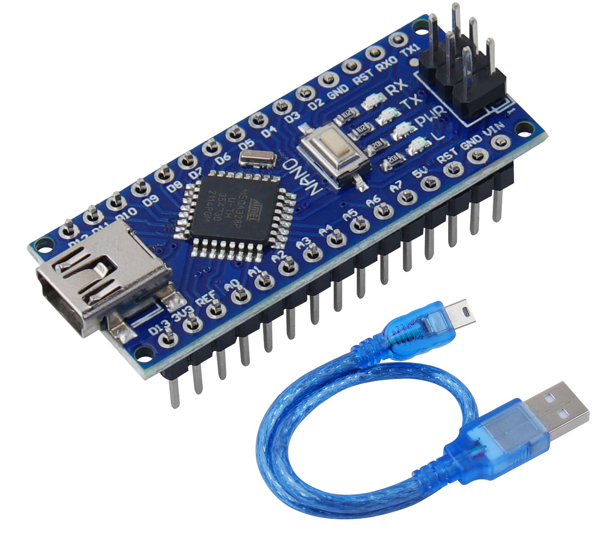
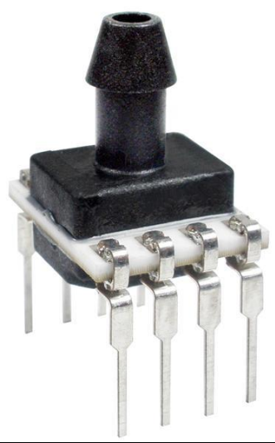
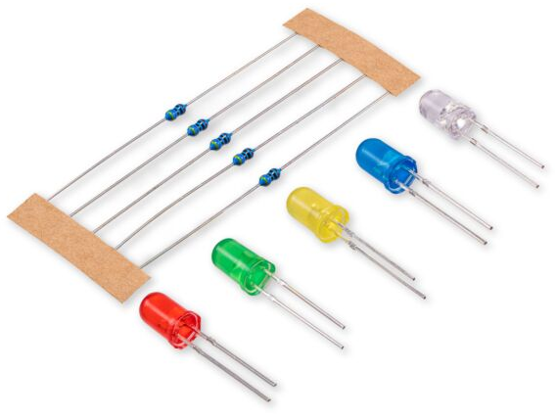
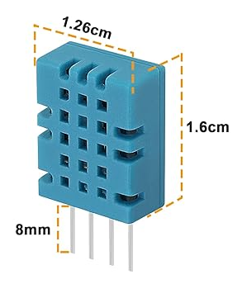
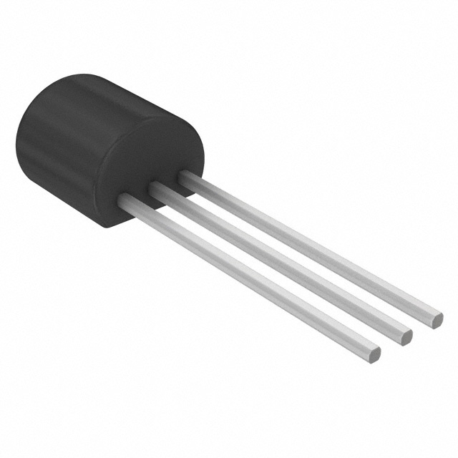
System Parts:
Function : measure temp, humidity and orientation.
Weight : must not exceed 200g.
Cost : system budget is <= $149.
Components:
1K resistors x 6, 4.7K resistor x 1.
DS18B20 External Temperature Sensor
TMP36GT9 Internal Temperature Sensor
(red, green, yellow, Orange)x1 and (blue)x2 LEDs.
Arduino nano V3.
Spark fun Open Log (SD card Module).
4GB Sd card .
Honeywell SSCDANV015PAAA5 Pressure Sensor
MPU6050 Gyro Sensor
9v Lithium Batteries (1200mAh)
Notes:
System parts were picked based on the system requirements:

Slide 7
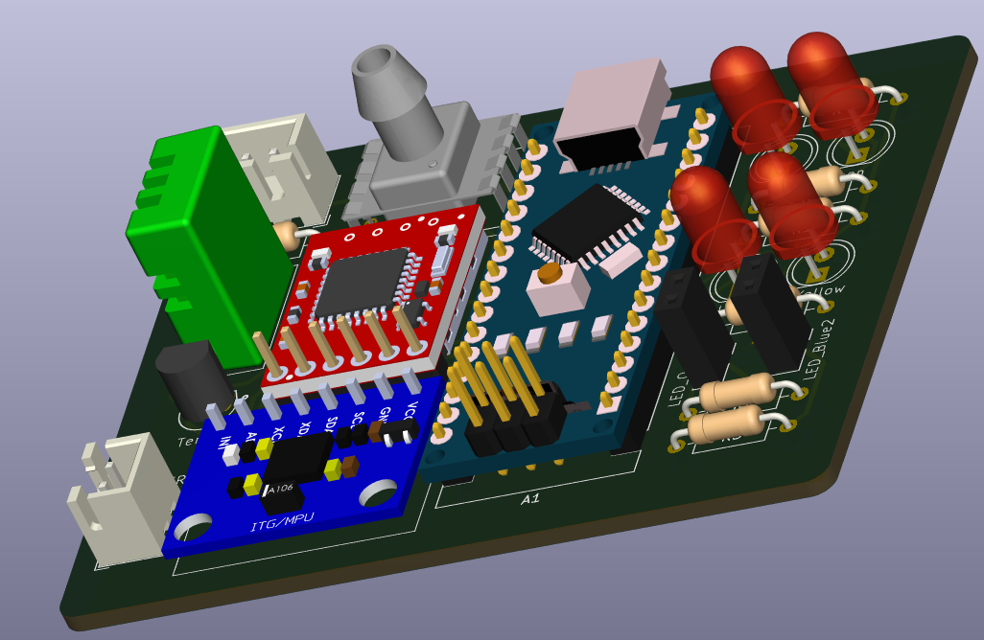
System Requirements Calculation:
Total Power Consumption :
Arduino nano consumes 20 mA * 9 volts = 180mW
Sensors consumes 135.105 at 5 volts = 675.5mW
Total power consumption 180mW + 675.5mW = 855.525mW
Total system current draw 155.105mA
Using a 9v (1200mAh) Lithium battery we get 1200mAh/155.105mA = 7.74 hours
Total Weight of the system = 6.379333 oz or 180.85g
Total cost of the system ≈ $105.97
Notes:
Part of the design process was to calculate the total weight of the PCB with all the components the cost of the system and power consumption.

Slide 8
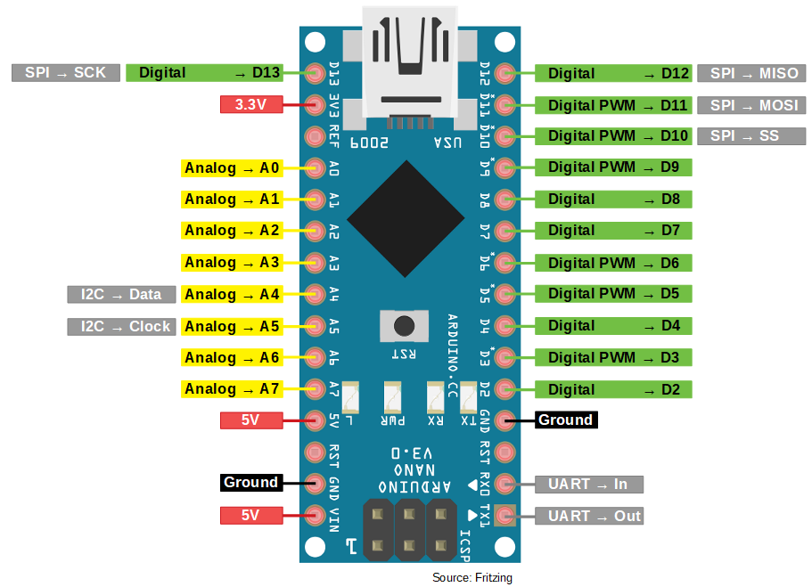
System MPU:
Arduino nano specification:
Low cost and small footprint.
Adequate digital and analog
pins for the sensors and the LEDs.
5v and 3.3v out Pins.

Slide 9
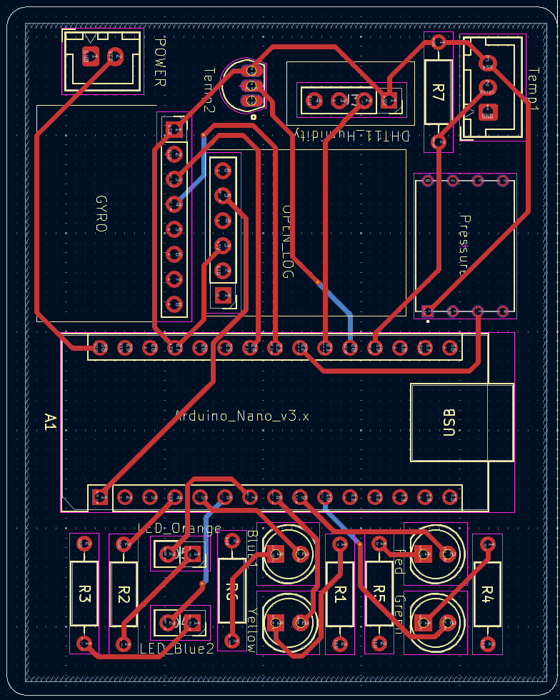
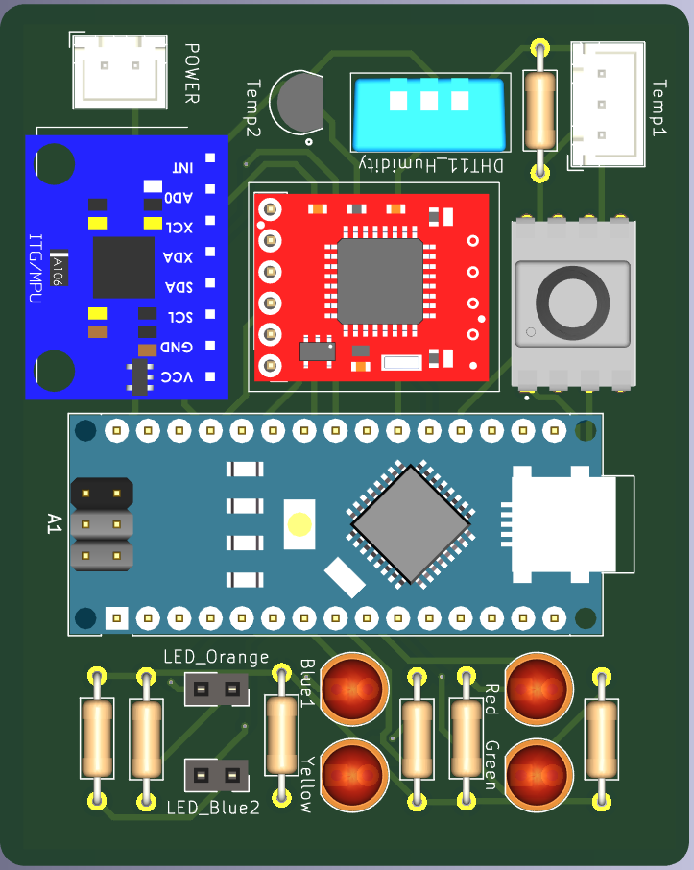
DESIGN:

Slide 10
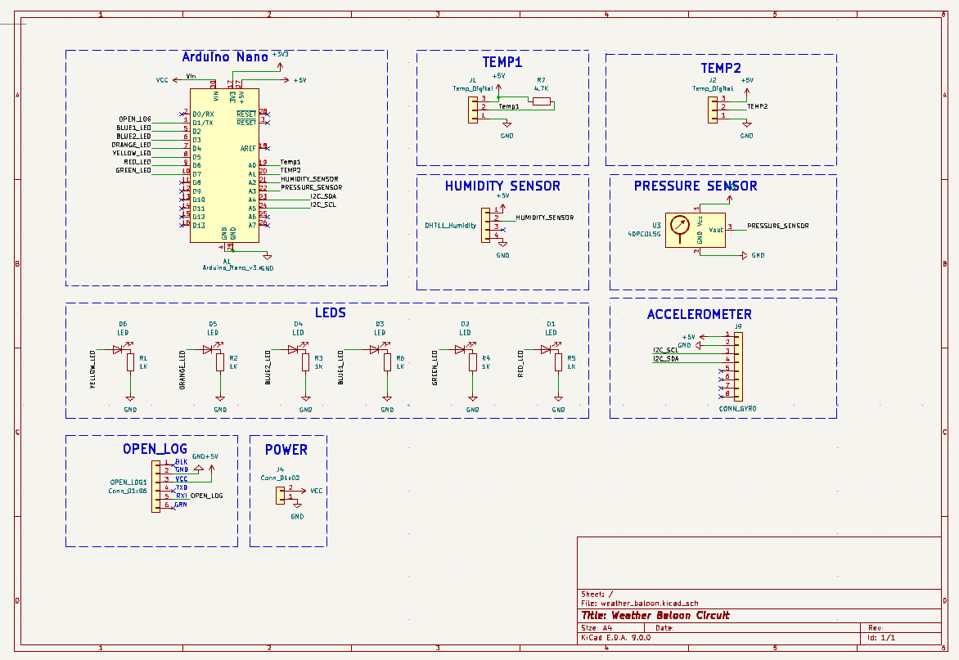
System Schematic Kicad:
Notes:
As you all familiar with Kicad used to design the system schematic

Slide 11
System Power Consumption, Cost & Weight :
Item | Current Draw | Price | Weight
DHT11 (Humidity Sensor) | 0.3mA | $1.00 | 0.141096 oz
open log (SD Card Module) | 6mA | $16.95 | 0.063493 oz
MPU6050(Gyro Module) | 5.1mA | $3.00 | 0.352740 oz
Arduino nano V3(MPU) | 20mA | $5.00 | 0.358383 oz
SSCDANV015PAAA5 | 2.7mA | $48.67 | 0.035274 oz
4GB SD Card | ----- | $9.00 | 0.070547 oz
PCB | ----- | $7.00 | 2.400000 oz
LEDS + Resistors | 120mA | $2.00 | 0.127800 oz
TMP36GT9Z(Temp2) | 50μA | $1.00 | 0.007408 oz
DS18B2(Temp1) | 1mA | $5.00 | 1.230000 oz
9V Lithium Battery | ----- | $7.35 | 1.600000 oz
Total: | 155.105mA | $105.97 | 6.379333 oz
Notes:
As a result of connecting multiple sensors to the system the total power consumption became 155.105 mA
using a 1200 mAh 9v battery would provide

Slide 12
Thank You

